Slide 1
AI TOOL for Early Stage Dementia Detection
CSE7101- Capstone Project
Review-3
Batch Number : CSE-176
Under the Supervision of,
Ms. Saiqa Khan N
Associate Professor
School of Computer Science Engineering
Presidency University
Roll Number | Student Name
20221CSE0268 | PIRUTHVIRAJ S
20221CSE0270 | RAFAEL V
20221CSE0260 | REVANTH ADITHYA V
Name of the Program : Computer Science and Engineering
Name of the HoD : Dr. Blessed Prince
Name of the Program Project Coordinator : Dr. Muthuraj
Name of the School Project Coordinators : Dr. Sampath A K , Dr. Geetha A

Slide 2
Problem Statement Number
Category (Hardware / Software / Both) : Software
Problem Description : Early detection of dementia is challenging due to subtle symptoms, time-consuming clinical tests, and lack of accessible diagnostic tools. Traditional diagnosis relies heavily on expert evaluation, which is costly and not scalable. There is a need for an intelligent, automated, and reliable system that can assist in early-stage dementia screening using AI techniques.

Slide 3
Content
Chapter 1 : Introduction to the AI tool – Brand Overview, Mission, and Products
Chapter 2 : Market Analysis – Stationery Market Trends and Online Competition
Chapter 3 : Target Audience – Clinic’s/Hospital’s (Large-scale or small-scale)
Chapter 4 : Marketing – Media, E-mail, Content Marketing, Customer Services, Newsletters and Influencer Reach
Chapter 5 : Analytics & ROI – Using Data-Driven Insights for Improvement
Chapter 6 : Conclusion & Future Roadmap – Scaling Sales, Deployment Growth and Increase in Accuracy

Slide 4
Chapter 1: Introduction to AI Tool - Brand Overview, Mission and Products
Overview : Dimensional AI is an advanced AI-powered system developed for early-stage dementia risk detection. The platform analyzes multi-dimensional data including speech patterns, cognitive assessment scores, and behavioral indicators to identify subtle cognitive decline. Dimensional AI provides a non-invasive, cost-effective, and scalable screening solution. Designed for integration within clinics, hospitals, and telemedicine platforms, the system leverages machine learning and deep learning techniques to deliver real-time, accurate risk predictions while supporting global dementia awareness initiatives.
Mission: The mission of Dimensional AI is to enable early and accurate dementia detection through AI-driven clinical insights. The project aims to reduce reliance on expensive, specialist-dependent diagnostic procedures by providing an intelligent decision-support system for healthcare professionals.
Products: Web-based AI Dementia Risk Screening Tool, Speech and cognitive data analysis, Secure and privacy-focused system, Multilingual speech analysis models.

Slide 5
Chapter 2: Market Analysis – Stationery Market Trends and Online Competition
🔹 Market Trends (Healthcare AI & Dementia):
Rising global dementia cases due to aging population.
Increasing demand for early-stage detection tools.
Rapid growth of AI in healthcare diagnostics.
Shift towards non-invasive and digital screening methods.
Expansion of telemedicine and remote monitoring.
Growing adoption of speech and behavioral biomarker analysis.
Higher investment in predictive and preventive healthcare technologies.
🔹 Online Competition:
Presence of AI-based cognitive screening startups.
Companies using imaging-based dementia detection models.
Speech-analysis and digital biomarker competitors.
Strong competition in accuracy and clinical validation.
Need for regulatory approval and data privacy compliance.
Differentiation required through real-time analysis and explainable AI.

Slide 6
Chapter 3: Target Audience – Clinic’s/Hospital’s(Large-scale or small-scale)
Segment target audience into:
Tier 1 Multi-specialty Hospitals
Tier 2 Clinics
Rural Health Centers
Telemedicine Platforms
Offer flexible pricing models:
SaaS subscription
Per-test pricing
Enterprise licensing
Enable integration with:
Hospital Management Systems (HMS)
Electronic Health Records (EHR)

Slide 7
Chapter 4: Marketing – Media, E-Mail, Campaigns, Influencer Reach, Customer Services, Newsletters
Media
Publish healthcare-focused press releases and research articles.
Social Media
Use LinkedIn to target doctors, hospitals, and healthcare professionals.
Newsletters
Send monthly updates on AI advancements and dementia research insights.
E-mails
Run targeted email campaigns offering demos and product information.
Influencer Reach
Collaborate with healthcare experts and AI thought leaders for credibility.
Customer Services
Provide dedicated technical support and training for institutional users.

Slide 8
Chapter 5: Analytics & ROI – Using Data-Driven Insights for Improvement
Develop advanced analytics dashboard showing:
Model accuracy
False positives/negatives
Risk classification trends
Implement continuous model retraining with anonymized datasets.
Demonstrate ROI through:
Reduced diagnosis time
Increased patient throughput
Lower cost per screening
Introduce predictive analytics for disease progression tracking.

Slide 9
Chapter 6: Conclusion & Future Roadmap – Scaling Sales, Deployment Growth and Increasing Accuracy
Conclusion:
Conduct large-scale clinical pilot studies.
Increase dataset size to improve accuracy beyond 90%.
Expand to mobile-based real-time speech analysis.
Deploy in 50+ clinics within 3 years.
Pursue international healthcare regulatory approval.
Integrate wearable cognitive monitoring devices in future.

Slide 10
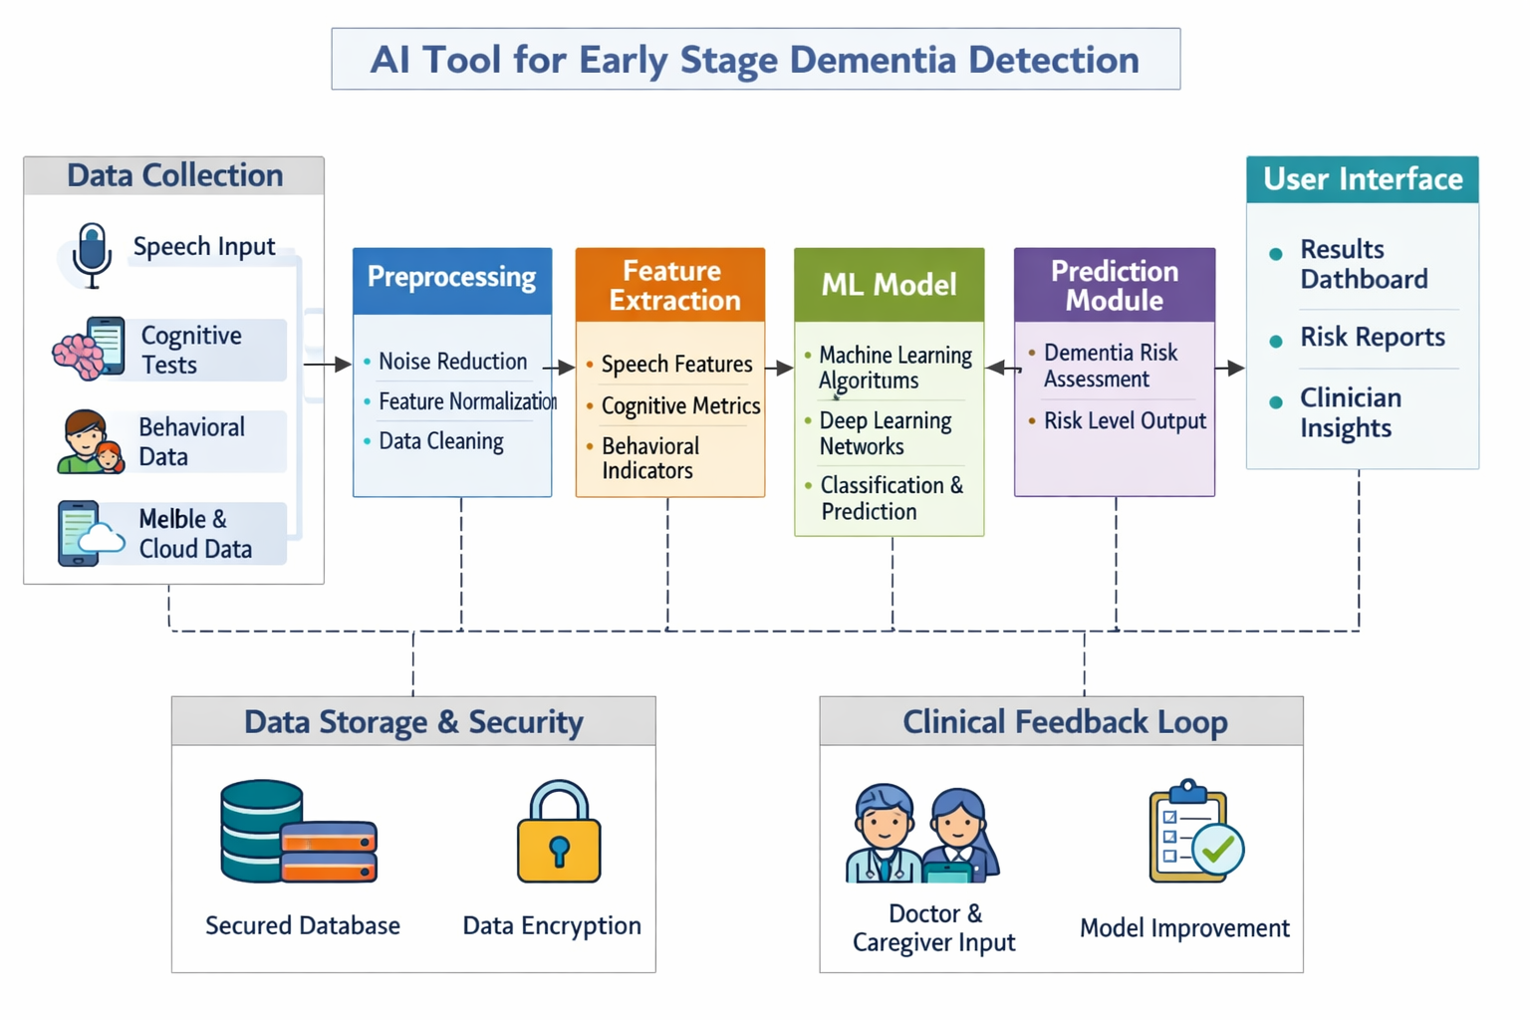
Architectural Diagram

Slide 11
Modules
NumPy
flask
pandas
scikit-learn
joblib

Slide 12
Hardware & Software Details
Hardware:
Processor: Intel Core 2 Quad Q6600 @ 2.40GHz / AMD Phenom 9850 Quad-Core @ 2.5GHz
Memory (RAM): 4GB (8GB recommended to avoid stuttering)
Graphics (GPU): NVIDIA 9800 GT 1GB / AMD HD 4870 1GB
Storage: ~100GB+ HDD
OS: Windows 10 64 Bit
Software:
Web : HTML5, CSS3, JavaScript, Bootstrap
Backend : PHP / Python Django
Database :MySQL / MongoDB

Slide 13
Github Link
The Github link provided should have public access permission.
Github Link :
https://github.com/dexty8147/AI-TOOL-FOR-EARLY-STAGE-DIMENTIA-DETECTION.git

Slide 14
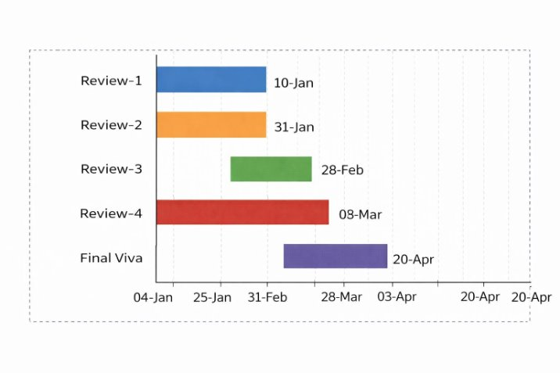
Timeline of the Project (Gantt Chart)
PHASE | ACTIVITY | START DATE | END DATE
Review-1 | Problem statement and objectives | 10-01-2026 | 16-01-2026
Review-2 | Literature review and model design | 31-01-2026 | 06-02-2026
Review-3 | Development and progress | 28-02-2026 | 06-03-2026
Review-4 | Testing and final progress | 03-04-2026 | 09-04-2026
Final Viva | Submission and viva | 20-04-2026 | 26-04-2026

Slide 15
References (IEEE Paper format)
[1]. World Health Organization(WHO), “Dementia – Key Facts,” WHO, 2023.https://www.who.int/news-room/fact-sheets/detail/dementia
[2]. Alzheimer’s Association, “What Is Dementia?,” Alzheimer’s Association, 2024.https://www.alz.org/alzheimers-dementia/what-is-dementia
[3]. M. Gauthier et al., “Artificial Intelligence in Early Detection of Dementia,” Journal of Medical Systems, vol. 45, no. 3, 2021.
[4]. A. Fraser et al., “Detecting Cognitive Decline Using Speech and Language Analysis,” IEEE Journal of Biomedical and Health Informatics, 2020.
[5]. Scikit-learn Developers, “Machine Learning in Python,” Scikit-learn documentation https://scikit-learn.org
[6]. TensorFlow, “An End-to-End Open Source Machine Learning Platform,” TensorFlow.org.
https://www.tensorflow.org

Slide 16
[7]. Librosa Developers, “Librosa: Audio and Music Signal Analysis in Python,” Librosa Documentation.https://librosa.org
[8]. Google Research, “Speech Recognition and Cognitive Analysis Using AI,” Google AI Blog.https://ai.googleblog.com
[9]. ChatGPT, OpenAI, “AI-assisted Research and Content Generation Tool,” OpenAI.https://www.openai.com
[10]. Petersen, R. C., “Early Diagnosis of Alzheimer’s Disease: Is MCI Too Late?,” Current Alzheimer Research, vol. 6,no. 4, pp. 324–330, 2009.
[11]. Jack, C. R. et al., “NIA-AA Research Framework: Toward a Biological Definition of Alzheimer’s Disease,”Alzheimer’s & Dementia, vol. 14, no. 4, pp. 535–562, 2018.
[12]. Shah, S. et al., “A Survey on Machine Learning Techniques for Dementia Detection,” Computer Methods andPrograms in Biomedicine, vol. 189, 2020.
[13]. López-de-Ipiña, K. et al., “Analysis of Speech and Language for Early Detection of Alzheimer’s Disease,”Neurocomputing, vol. 150, pp. 392–402, 2015.

Slide 17
[14]. World Alzheimer Report 2023, “Reducing Dementia Risk: Never Too Early, Never Too Late,” Alzheimer’s DiseaseInternational (ADI).
[15]. Esteva, A. et al., “A Guide to Deep Learning in Healthcare,” Nature Medicine, vol. 25, pp. 24–29, 2019.

Slide 18


